Slide 1
Introduction to GUI Programming in Java

Slide 2
Elements of GUI Programming
Components
Visual objects that appear on the screen
Layouts
Control over the positioning of components within a container
Events
Responses to user actions
Graphics
Lines, shapes, colors, fonts, etc.
All are supported in Java library packages.

Slide 3
Components/widgets
Two categories of Java Component classes:
AWT – Abstract Windows Toolkit (java.awt package)
The older version of the components
Rely on “peer architecture”…drawing done by the OS platform on which the application/applet is running
Platform-dependent look.
Considered to be “heavy-weight”
Swing (javax.swing package)
Newer version of the components
No “peer architecture”…components draw themselves
Most are considered to be “lightweight”

Slide 4
Swing VS. AWT
Never mix Swing and AWT components
If you know AWT, put ‘J’ in front of everything
AWT: Button
Swing: JButton
Swing does all that AWT does, but better.

Slide 5
Using a GUI Component
Create it
Configure it
Add children (if container)
Add to parent (if not JFrame)
Listen to it
order important

Slide 6
Containers
Descendents of the java.awt.Container class
Components that can contain other components.
Use a layout manager to position and size the components contained in them.
Components are added to a container using one of the various forms of its add method
Depending on which layout manager is used by the container

Slide 7
Container Hierarchy
Top-level container:
place for other Swing components to paint themselves
e.g., JFrame, JDialog, Japplet
Intermediate container:
simplify positioning of atomic components
e.g., JPanel, JSplitPane, JTabbedPane
Atomic components:
self-sufficient components that present information to and get input from the user
e.g., JButton, JLabel, JComboBox, JTextField, JTable

Slide 8
Hierarchy Sample
Frame
Panel
Panel
Panel
Panel
Label
checkbox
RadioButton
Text Field
List
Scrollbar
Table
Text Area
ComboBox
Panel
Button
Button
Button

Slide 9
Top Level Containers
Every program that presents a Swing GUI contains at least one top-level container.
A Top level container provides the support that Swing components need to perform their painting and event-handling.
Swing provides three top-level containers:
JFrame (Main window)
JDialog (Secondary window)
JApplet (An applet display area within a browser window)

Slide 10
JFrame
A frame implemented as an instance of the JFrame class, is a window that has decorations such as a border, a title and buttons for closing and iconifying the window.
The decorations on a frame are platform dependent.
Applications with a GUI typically use at least one frame.

Slide 11
Some Jframe methods
JFrame() - Constructs a new frame that is initially invisible.
JFrame(String title)
setSize(width, height);
pack();
setLocation(x, y);
setVisible(true);
setResizable(false);
getContentPane();

Slide 12
Content Pane
When a frame is created, the content pane is created with it
To add a component to the content pane (and thus to the frame), use:
frameName.getContentPane().add(component name);
where frameName is the name of the frame

Slide 13

Example 1
import javax.swing.*;
public class HelloWorldSwing {
public static void main(String[] args) {
JFrame frame = new JFrame("HelloWorldSwing");
JLabel label = new JLabel("Hello World");
frame.getContentPane().add(label);
frame.setVisible(true);
}
}
Title
JFrame
This gray area is the content pane of this frame.
JLabel

Slide 14
Example 2
In this example a custom frame is created
import javax.swing.*;
public class HelloWorldFrame extends JFrame {
public HelloWorldFrame() {
super(“HelloWorldSwing”);
JLabel label = new JLabel("Hello World");
getContentPane().add(label);
setVisible(true);
}
public static void main(String[] args) {
HelloWorldFrame frame = new HelloWorldFrame();
}
}

Slide 15
JComponents (also called “widgets”)
JComponent is the base class for all Swing components except top-level containers.
JLabel, JButton, JList, JPanel, JTable, ...
To use a component that inherits from JComponent, it must be placed in a top-level container.

Slide 16
JPanels/Panes
The terms “pane” and “panel” are used interchangeably in Java
Intermediate Level Containers.
Panes hold a window’s GUI components
Every frame has at least one pane, the default “Content Pane”
Useful for layout
If you want to group certain GUI components together, put them inside a pane, then add that pane to the frame
Needed to add components to the frame
Nothing can be added directly to the frame; instead, everything, including other panes, is added to the frame’s content pane

Slide 17
JPanel methods
JPanel() - Creates a new JPanel with a double buffer and a flow layout.
JPanel(boolean isDoubleBuffered) - Creates a new JPanel with FlowLayout and the specified buffering strategy.
JPanel(LayoutManager layout) - Create a new buffered JPanel with the specified layout manager.
JPanel(LayoutManager layout, boolean isDoubleBuffered) - Creates a new JPanel with the specified layout manager and buffering strategy.

Slide 18
JLabel
A display area for a short text string or an image, or both.
A label does not react to input events.
Methods:
JLabel() - Creates a JLabel instance with no image and with an empty string for the title.
JLabel(String text) - Creates a JLabel instance with the specified text.
JLabel(String text, alignment)
Alignemnt is eigher JLabel.LEFT, JLabel.CENTER, JLabel.RIGHT
JLabel

Slide 19

JButton
Java class that allows you to define a button
Multiple constructors allow you to initialize a button with a predefined label and/or a predefined icon
Although the button’s “action” can be defined in the constructor, defining a button’s action can take many lines of code and should be done separately
JButton methods
JButton() - Creates a button.
JButton(String text) - Creates a button with text.

Slide 20

JTextField
A Java text field is essentially the same as a text area, only limited to one line
Very similar set of methods
JPasswordField is the same as JTextField, only the contents are hidden
Different constructors allow you to predefine the number of columns and/or the default text
JLabel
JTextField

Slide 21
JTextField methods
JTextField() - Constructs a new TextField.
JTextField(String text) - Constructs a new TextField initialized with the specified text.
JTextField(String text, int columns) - Constructs a new TextField initialized with the specified text and columns.
getText() - Return the text of this field as a string object
void setHorizontalAlignment(int alignment)
JTextField.LEFT
JTextField.CENTER
JTextField.RIGHT
JTextField.LEADING
JTextField.TRAILING

Slide 22
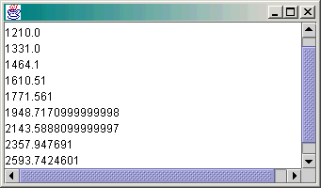
JTextAreas
A text area is just a white space of variable size that can hold text
If text goes out of the area’s bounds, it will exist but some of it will not be seen
Wrap the text area in a scrollable pane
JTextArea with Scroll Bars

Slide 23
JTextarea Methods
JTextArea() - Constructs a new TextArea.
JTextArea(int rows, int columns) - Constructs a new empty TextArea with the specified number of rows and columns.
JTextArea(String text) - Constructs a new TextArea with the specified text displayed.
JTextArea(String text, int rows, int columns) - Constructs a new TextArea with the specified text and number of rows and columns.
textarea.setText(String);
textarea.getText(String);
textarea.append(String);
textarea.setEditable(boolean);

Slide 24
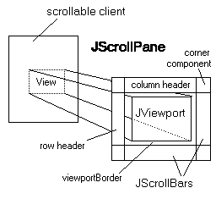
JScrollPane
JScrollPane basically consists of JScrollBars, a JViewport, a column header and a row header.
Methods
JTextArea textArea = new JTextArea("Type here",5, 20);
JScrollPane scrollPane = new JScrollPane(textArea);
frame.setContentPane(scrollPane);

Slide 25

JList
A simple GUI object design to hold lists of objects and allow users to make selections from the list
Can be created from a ListModel, a Vector, or an array (all essentially lists themselves)
Jlist methods
JList() - Constructs a JList with an empty model.
JList(Object[] listData) - Constructs a JList that displays the elements in the specified array.

Slide 26
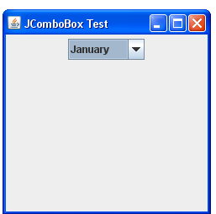
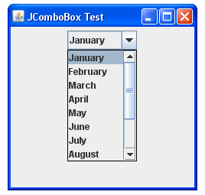
JComboBox
Drop-down box
Can be:
User-editable:
allows user to type in a value in the field similar to a JTextField
list.setEditable( true );
User-un-editable:
user must select an entry from the drop-down list
default

Slide 27
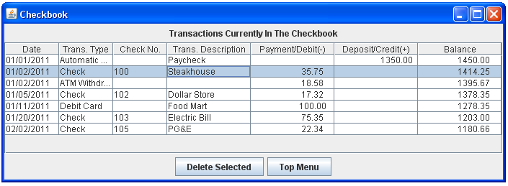
JTable
Usually created from a DefaultTableModel
Can also be created from an array of arrays or a Vector of Vectors, or can have no initial data
Create a DefaultTableModel, then initialize a table from the DefaultTableModel
Some methods
Jtable()
JTable(int numRows, int numColumns)
JTable

Slide 28
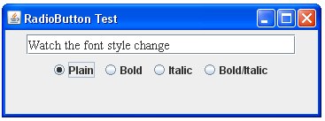
RadioButton
Come in groups – only 1 selected per group
Make radiobuttons
Make group
Add radiobuttons to group
ActionListener

Slide 29
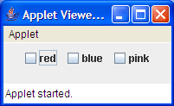
JCheckBox
A check box can be toggled checked or unchecked
Can have one or more checkboxes selected (as opposed to radio buttons)

Slide 30
How to Layout Widgets?
Two approaches
Manually specify absolute positions
Use layout managers

Slide 31
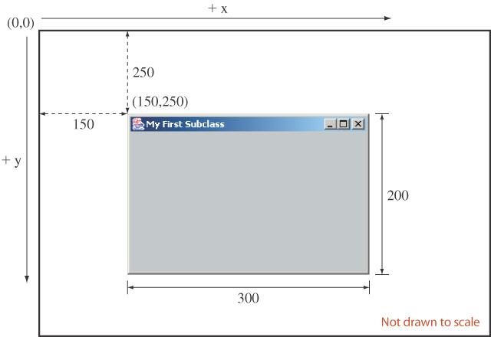
Manually specify absolute positions
Use component methods such as:
public void setLocation(Point p)
public void setSize(int width, int height)

Slide 32
Layout Managers
Layout managers are AWT software components which have the ability to lay out widgets/components by their relative positions.
Associated with containers.
Automate the layout of elements
When elements are added to the container
When the window is resized
automatically adjust the positions and sizes of the elements.

Slide 33
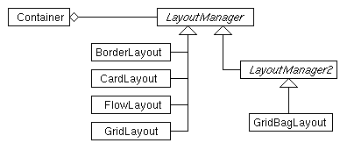
Hierarchy of Layout Managers

Slide 34
Using Layout Managers
Method | Description
setLayout(lm) | Set lm as the layout manager
add(comp) | Add a component
add(comp, cst) | Add a component with constraint
setLayout(new FlowLayout());
add(new JButton(“Increment"));
add(new JButton(“Decrement”));

Slide 35
Layout Management
When using the add method to put a component in a container, the container’s layout manager must be taken into account.
Relative position (BorderLayout)
panel.add(component, BorderLayout.CENTER);
Order of addition (BoxLayout, GridLayout, ...)
panel.add(component);

Slide 36
FlowLayout
Places components from left to right, starting new rows if necessary.
Default LayoutManager of JPanel
Left to right,
Top to bottom

Slide 37
FlowLayout example
import javax.swing.*;
import java.awt.*;
public class flow {
public static void main(String[] args) {
JFrame frm = new JFrame("Flow Layout Test");
Container contentPane = frm.getContentPane();
contentPane.setLayout(new FlowLayout());
for (int i=0; i<=9; ++i)
contentPane.add(new JButton(""+i));
frm.pack();
frm.setSize(318,220);
//frm.setResizable(false);
frm.setDefaultCloseOperation(JFrame.EXIT_ON_CLOSE);
frm.setVisible(true);
}
}

Slide 38
BorderLayout
Has five areas available to hold components
north, south, east, west and center
All extra space is placed in the center area
Only the center area is affected when the container is resized.
Default layout manager of content panes.
n
c
w
e
s

Slide 39
BorderLayout example
import javax.swing.*;
import java.awt.*;
public class border {
public static void main(String[] args) {
JFrame frm = new JFrame(“Border Latout Test");
Container contentPane = frm.getContentPane();
contentPane.setLayout(new BorderLayout());
contentPane.add(new JButton(" 0 "), BorderLayout.NORTH);
contentPane.add(new JButton(" 1 "), BorderLayout.SOUTH);
contentPane.add(new JButton(" 2 "), BorderLayout.EAST);
contentPane.add(new JButton(" 3 "), BorderLayout.WEST);
contentPane.add(new JButton(" 4 "), BorderLayout.CENTER);
frm.pack();
frm.setSize(318,220);
frm.setDefaultCloseOperation(JFrame.EXIT_ON_CLOSE);
frm.setVisible(true);
}
}

Slide 40
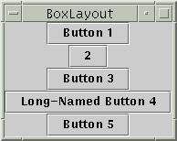
BoxLayout
The BoxLayout class puts components in a single row or column.
It respects the components' requested maximum sizes, and also lets you align components.

Slide 41
GridLayout
Places components in a requested number of rows and columns.
Components are placed left-to-right and top-to-bottom.
Forces all components to be the same size
as wide as the widest component's preferred width
as high as the highest component’s preferred height

Slide 42
GridLayout example
import javax.swing.*;
import java.awt.*;
public class grid {
public static void main(String[] args) {
JFrame frm = new JFrame(“Grid Layout Test");
Container contentPane = frm.getContentPane();
contentPane.setLayout(new GridLayout(3, 4));
for (int i=0; i<=9; ++i)
contentPane.add(new JButton(""+i));
frm.pack();
frm.setSize(318,220);
//frm.setResizable(false);
frm.setDefaultCloseOperation(JFrame.EXIT_ON_CLOSE);
frm.setVisible(true);
}
}

Slide 43
CardLayout
Components are organized as a deck of cards.
Can only be shown one at a time.
Methods:
void add(String name, Component comp)
void first(Container parent)
void show(Container parent, String name)
One at a time

Slide 44
CardLayout example
public class card implements ActionListener {
static CardLayout contentPaneLayout;
static JButton B1 = new JButton("To Card 2");
static JButton B2 = new JButton("To Card 1");
static JPanel contentPane;
public void actionPerformed(ActionEvent e) {
Object source = e.getSource();
if (source==B1) contentPaneLayout.show(contentPane, "Card 2");
if (source==B2) contentPaneLayout.show(contentPane, "Card 1");
}

Slide 45
public static void main(String[] args) {
JFrame frm = new JFrame("Card Layout Test");
contentPane = (JPanel) frm.getContentPane();
contentPane.setLayout(contentPaneLayout=new CardLayout());
JPanel card1 = new JPanel();
JPanel card2 = new JPanel();
card1.add(new Label("This is card 1"));
card2.add(new JTextField("This is Crad 2", 20));
card1.add(B1); card2.add(B2);
contentPane.add("Card 1", card1);
contentPane.add("Card 2", card2) ;
contentPaneLayout. show(contentPane, "Card 1");
ActionListener AL = new card() ;
B1.addActionListener(AL); B2.addActionListener(AL);
frm.pack();
frm.setDefaultCloseOperation(JFrame.EXIT_ON_CLOSE);
frm.setVisible(true);
}
}

